Slide 1
Bird species identification from an image
Manideep Chenna(042)
Jagadeesh reddie(039)
Batch no:122

Slide 2
Table of Contents
Problem Statement
Flow Chart
Flask
Results

Slide 3
Problem Statement
The project aims to quantify the description of different bird species using machine learning techniques and use it as a useful tool for bird species identification from images.
This project attempts to design and adopt the bird species identification system based on the image.

Slide 4
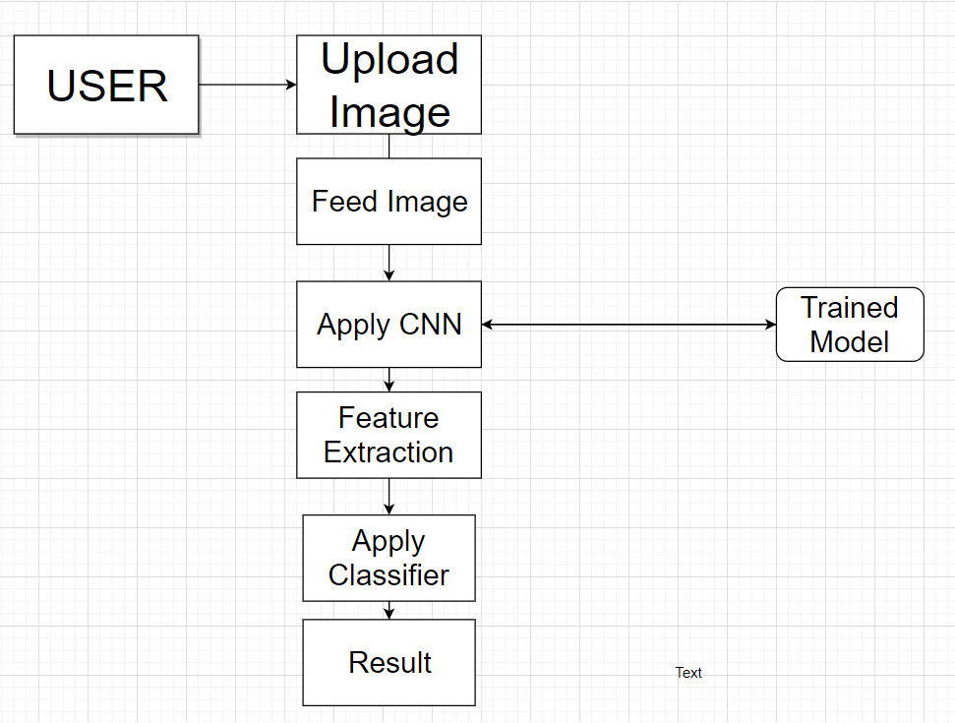
Flow Chart

Slide 5
Dataset
The dataset is avaliable at Caltech-UCSD Birds-200-2011 dataset.
Caltech-UCSD Birds 200 (CUB-200) is an image dataset with photos of 200 bird species (mostly North American).
Number of categories: 200
Number of images: 11788

Slide 6
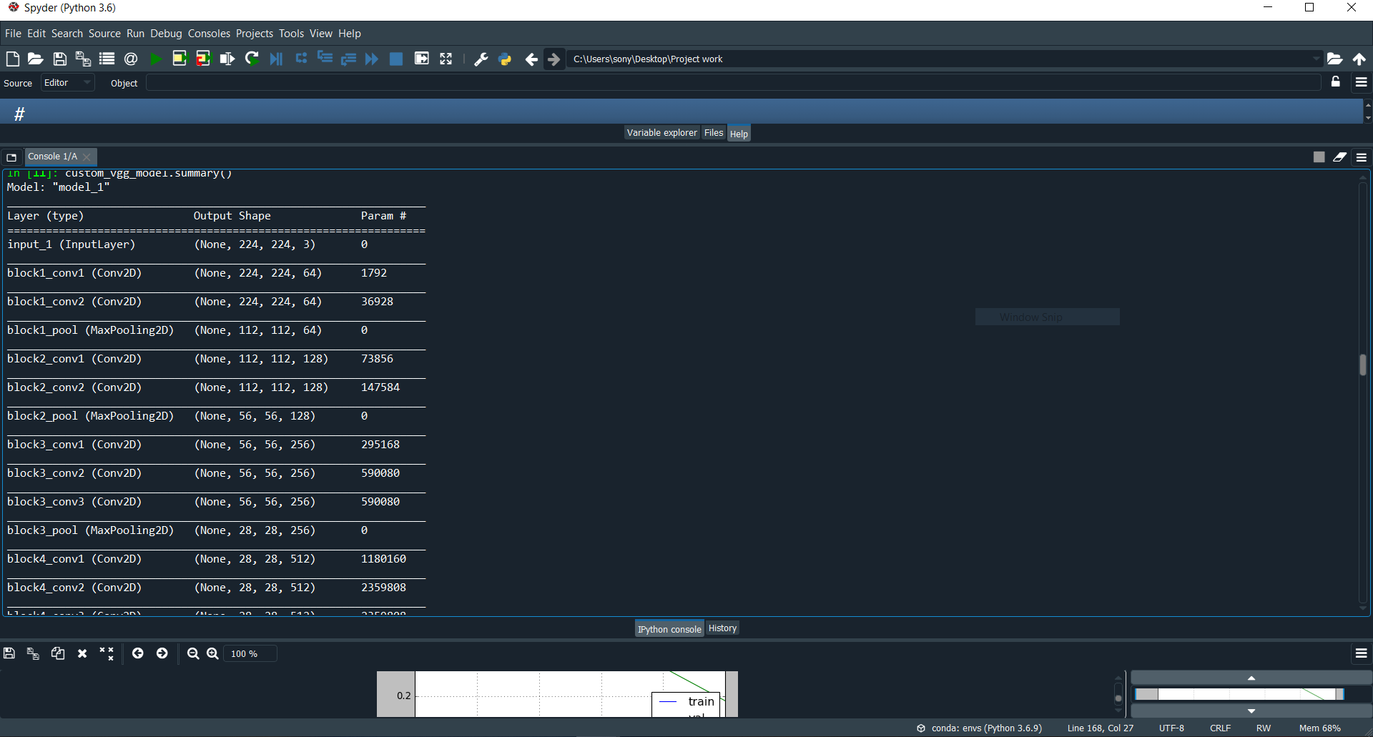

Intermediate Results

Slide 7
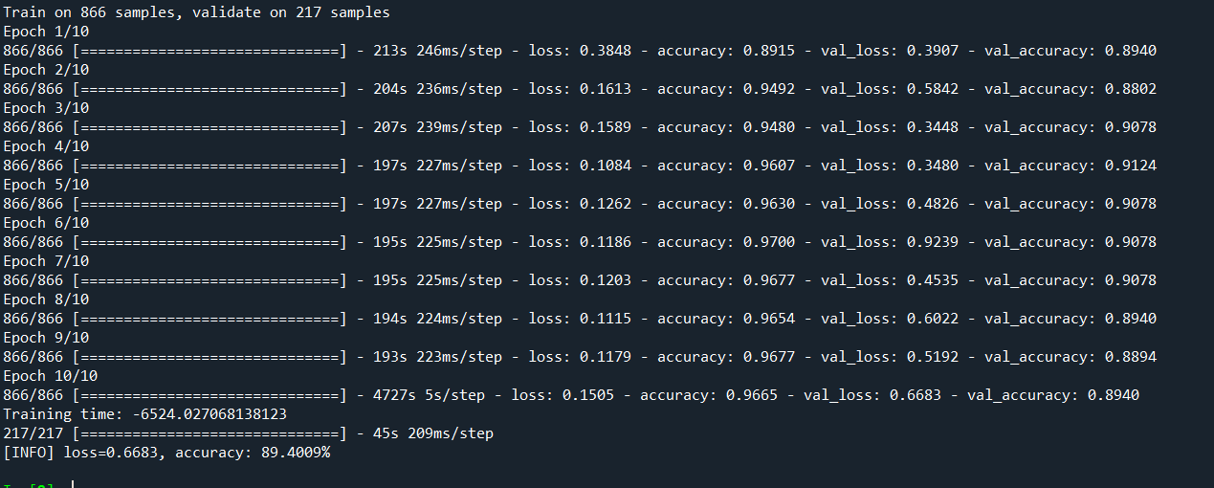
Intermediate Results
Accuracy:89.4009%, Loss=0.6683

Slide 8
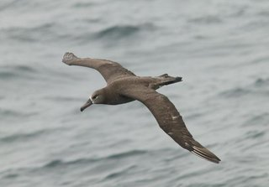
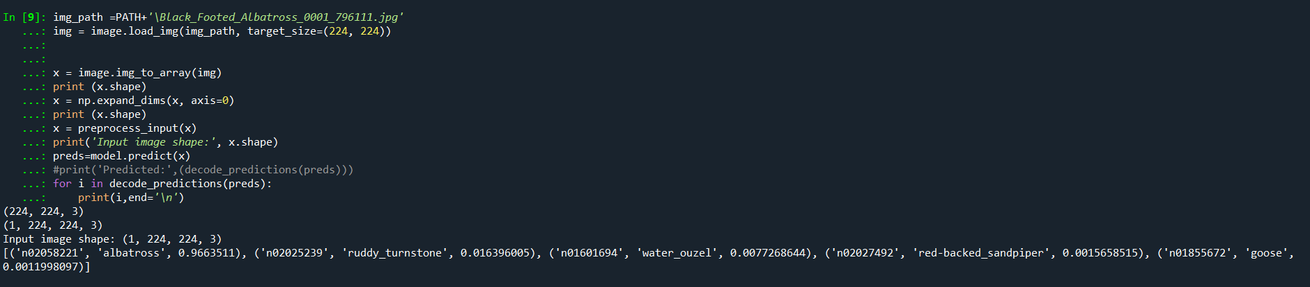
Predicting

Slide 9
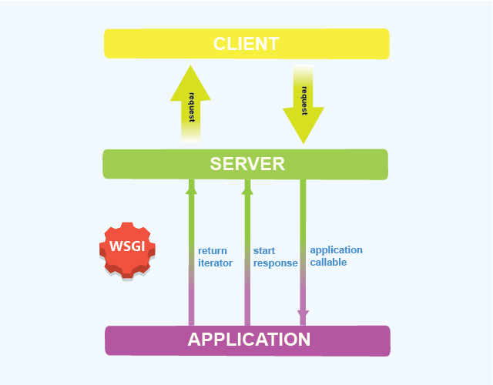
FLASK
Flask Architecture
Flask is a popular, extensible web microframework for building web applications with Python.
It is a lightweight WSGI web application framework.
WSGI:Web Server Gateway Interface

Slide 10
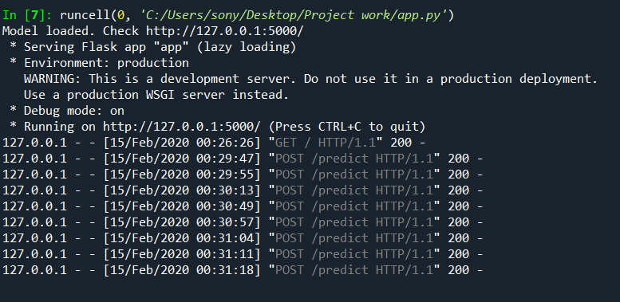
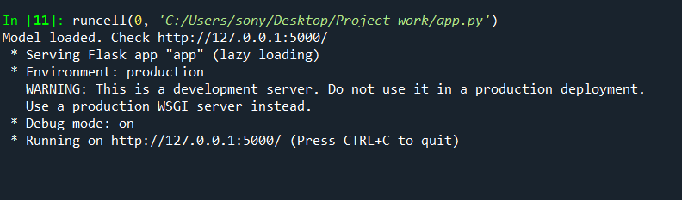
Local Computer Host(Server)

Slide 11
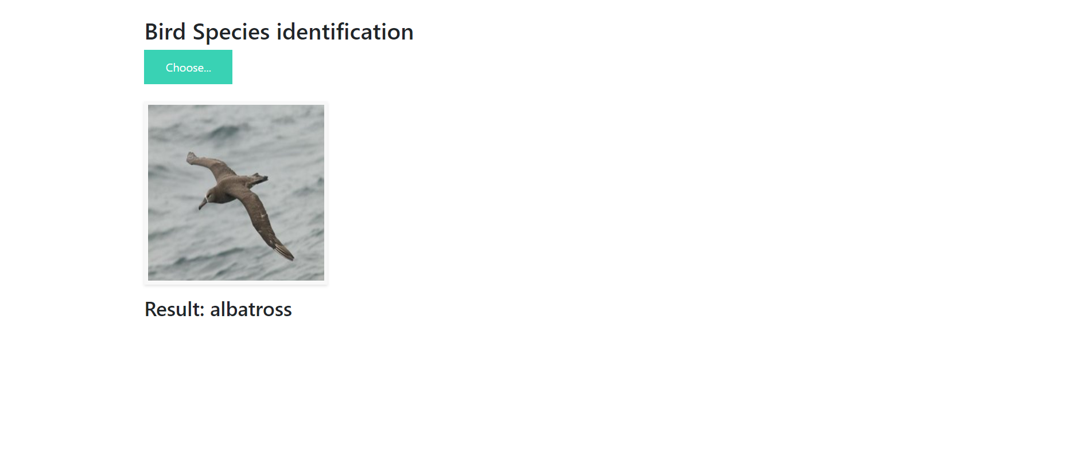
Testing
Model Deployed in Web

Slide 12
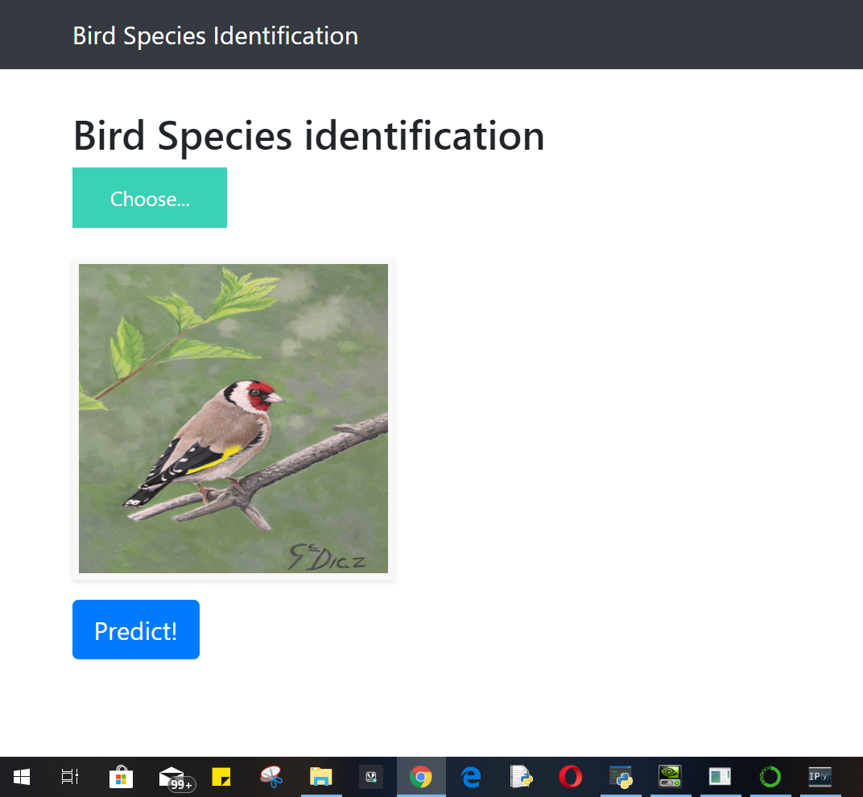
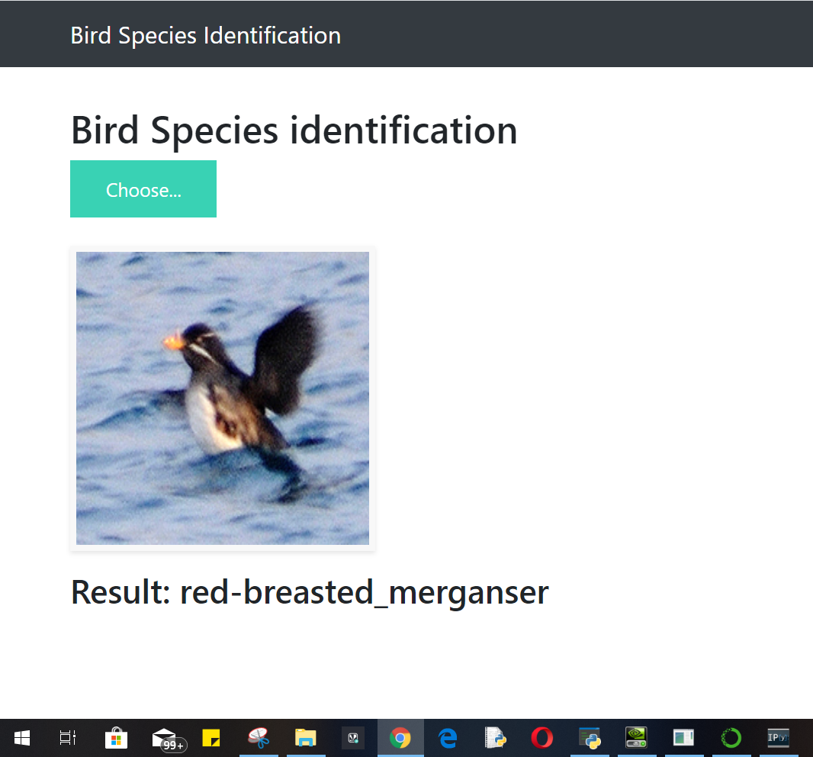

Slide 13
THANK YOU ☺ ☺

